Slide 1
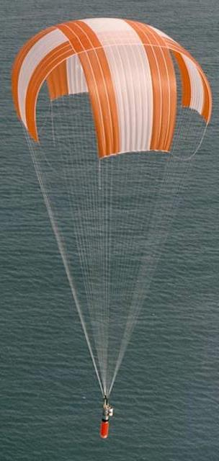
Flight
Parachutes
LabRat Scientific
© 2019

Slide 2
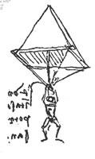
What is a Parachute?
A parachute is a flexible device who’s primary purpose is to produce DRAG
Modern parafoils also generate lift that result in smaller canopies and the ability to maneuver
The thin canopy material and the slender suspension lines allow a BIG device to be packed in a small volume

Slide 3
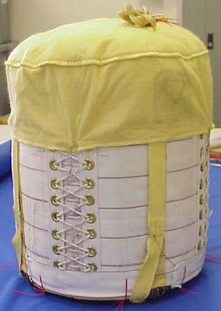
Deployed Parachute
(Large Structure)
Packed Parachute
(Small Package)

Slide 4
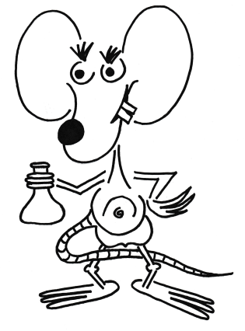
The purpose of the parachute is to create a large Drag Area.
Skydiver Drag Area prior to parachute opening
Drag Area after the parachute opening

Slide 5
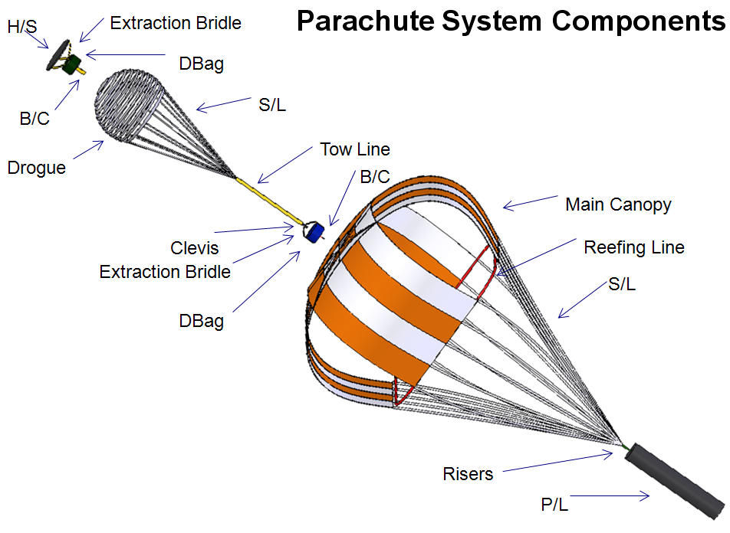

Slide 6
Major Components of a Parachute System
Drogue Parachute: Stabilizes the payload and sometimes provides
initial deceleration.
Main Parachute: Provides primary deceleration to slow the payload
down to a survivable impact velocity.
Tow Line: Connects the drogue chute to the main parachute bag.
When the main parachute is released the drogue chute
pulls the bag off the main parachute.
Suspension Lines: Connects the parachute canopy to the payload.
Reefing Lines: Restrict the size of the parachute base to minimize opening
loads. The reefing lines are then cut to allow the canopy
to fully open.

Slide 7
What keeps the parachute open?
The force applies a vertical force component
and a horizontal force component to the base of the canopy.
The force (weight) is transferred along the suspension lines.
The suspended body has weight.

Slide 8
What keeps the parachute open?
These forces tend to pull the canopy closed…
Which is not a good thing to see if you are a sky diver…

Slide 9
What keeps the parachute open?
As the canopy moves through the atmosphere it captures a huge bubble of air.
Bubble of “pressurized” air
Internal Press. = ½ x Air Density x Velocity²
The internal pressure forces created by this bubble offset the suspension line tension forces and the canopy stays open…

Slide 10
Internal Pressure Unit Analysis
1 Kg m²
Pressure = ---- x -------- x ---------
2 m³ sec²
The “1/2” is unitless so it can be dropped from the analysis…

Slide 11
Internal Pressure Unit Analysis
Kg m²
Pressure = -------- x ---------
m³ sec²
Recall:
N
Kg = --------------
m / sec²
N x sec²
Kg = --------------
m
Kg
= --------------
m x sec²
N x sec² 1
= ------------- x -------------
m m x sec²
N
= ------------
m²
This is the units for pressure…

Slide 12
Parachute Physics
Drag
Drag and Weight act on a body as it falls through the atmosphere.
Drag
Gravity (weight)
When the parachute deploys, it creates more drag area, and thus more drag.
Gravity (weight)
According to Newton’s 2nd Law of Motion, the addition of more drag (an adverse force) results in a lower acceleration.
Force Weight - Drag
F = Ma a = ---------- a = -------------------
Mass Mass
Whether the body actually decelerates (negative acceleration) or not depends on the velocity and altitude (and thus the drag…) when the chute is deployed…

Slide 13
Parachute Physics
If the body has a high velocity at parachute deployment, the drag may be greater than the weight. In this case, the body will have a negative acceleration (deceleration) and the system will slow down.
Weight - Drag
a = --------------------
Mass
If the body has a low velocity at parachute deployment, the drag may be less than the weight. In this case, the body will continue to accelerate and speed up, but not with the same magnitude.
Weight - Drag
a = -------------------
Mass
In either case, the velocity will change (increase or decrease). And as the velocity changes so does the drag... Eventually the system will reach an equilibrium point where the drag equals the weight.

Slide 14
Why does the system move towards an equilibrium point?
We can understand this a little better by examining the Drag Equation:
DRAG = ½ x Air Density x Velocity² x Drag Coeff x Area
If drag starts off lower than the weight, the acceleration will be positive. This means the velocity will increase. Increasing velocity means increasing drag. Eventually drag will increase to a point where it will equal the weight and acceleration will become zero…
Weight – Drag
a = -------------------
Mass
If drag starts off higher than the weight, the acceleration will be negative and the system will slow down. Decreasing velocity means decreasing drag. Eventually drag will decrease to a point where it will equal the weight and acceleration will become zero...
Weight – Drag
a = ----------------------
Mass

Slide 15
Parachute Physics
When drag is equal to the weight, the composite force (numerator) becomes zero, which makes the overall acceleration zero...
Weight - Drag
a = --------------------
Mass
An acceleration of zero means the velocity is not changing. When velocity stops changing, the descending system has reached “Terminal Velocity”.
When the system has reached Terminal Velocity it will descend at a constant velocity until it hits the ground.

Slide 16
Using Terminal Velocity to Design a Parachute
DRAG = ½ x Air Density x Velocity² x Drag Coeff x Area
For Terminal Velocity: DRAG = WEIGHT
When at Terminal Velocity, the Drag Equation can then be expressed as follows:
WEIGHT = ½ x Air Density x Velocity² x Drag Coeff x Area
Fixed
Fixed
Fixed – sort of…
We desire to keep this reasonably low
Fixed once we select a chute type
We can alter the chute size
Lets apply some algebra to get a more useful version of the equation…
2 x Weight
Area = -----------------------------------------------------------------
Air Density x Velocity² x Drag Coeff

Slide 17
2 x Weight
Area = -----------------------------------------------------------------
Air Density x Velocity² x Drag Coeff

Slide 18
2 x Weight
Area = -----------------------------------------------------------------
Air Density x Velocity² x Drag Coeff
The system weight is known
Assume a standard air density at impact altitude (the ground…)
The drag coefficient depends on the type of chute selected.
The designer selects the desired impact velocity.

Slide 19
Parachute Design Process
Determine suspended weight (e.g. rocket)
Select desired shape
Select the theoretical Drag Coefficient (Cd)
Determine the desired impact velocity
Too fast could result in a broken rocket
Too slow could result in high wind drift
A good starting point might be 20 ft/sec…
Calculate the canopy area that is required to give the desired theoretical impact (terminal) velocity

Slide 20
Simple Parachute Types
Cross
Fairly easy to build (straight cuts)
Lower Cd
More stable (less swinging)
Square
Easiest to build
Intermediate Cd
Less stable
Flat Circular
A little more difficult to build
Highest Cd of basic shapes
Least stable

Slide 21
Typical Drag Coefficients for Full Scale Parachutes
Chute Type | Drag Coefficient
Flat Circular | 0.78
Square | 0.73
Cross | 0.70
These are the drag coefficients that are typically used when designing full scale parachute systems. These are not the values obtained when small-scale drop tests are conducted…

Slide 22
Example Problem
Determine the canopy area needed for a Flat Circular parachute that will allow a 44,500 N (10,000 lb) elephant to land on the ground at 5 m/sec.
For a Flat Circular Parachute, Cd = 0.78. We can assume the elephant will be landing on a spot that is at sea level. As such we can assume the air density is 1.225 kg/m³.
2 x Weight
Area = -----------------------------------------------------------------
Air Density x Velocity² x Drag Coeff
2 x 44,500 kg * m/sec²
Area = --------------------------------------------------------
1.225 kg/m³ x (5.0 m/sec)² x 0.78
= 3,725 m²
(34.4 m Radius)

Slide 23
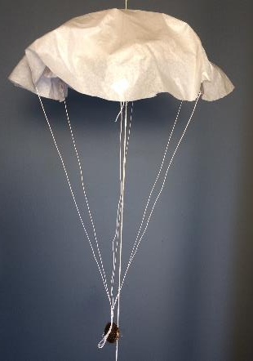
Parachute Testing

Slide 24
Parachute Drop Testing
Small parachute models can be tested by conducting simple drop tests.
All that is needed is a wind-free area to drop the parachutes and a stop watch to measure descent time.
Distance needed to reach Terminal Velocity.
The drop height will depend on the size of the parachute. Small chutes (about the size of a facial tissue) can be tested in a 8 ft tall room.
Overall Drop Height
Distance used to determine velocity.
For a tissue paper or model rocket sized parachute, the parachute should be allowed to fall for about 0.3 m before starting the stop watch. This allows Terminal Velocity to be achieved.

Slide 25
Testing Process
Measure the canopy area
Measure the system weight
This will be the assumed system drag (assuming the system falls at terminal velocity during the tests)
Caution – too much suspended weight may prevent terminal velocity from be achieved quickly enough
Conduct drop tests
Make 5-10 drops for each configuration – record fall times
Calculate average fall times and associated descent velocities
Calculate Drag Coefficients
Tabulate and assess results

Slide 26
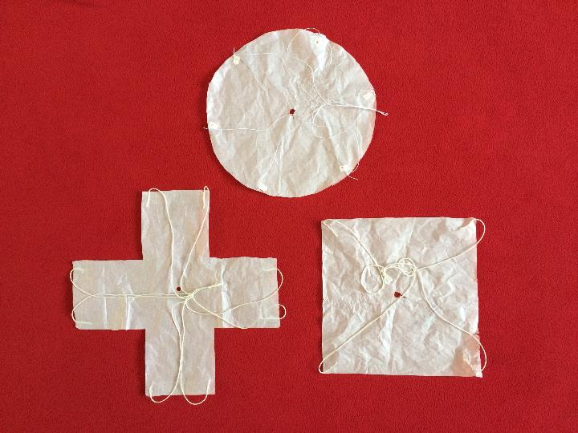
Test Parachutes
Flat Circular
The parachutes were made out of light weight tissue paper and the all had the same area when laid out flat. This is known as the “reference area (S)”
Area = 0.05 m²
Cross
Square

Slide 27
Three suspended weights were used for each chute. If we assume the chutes are at terminal velocity during the descent (which they were…), the weights then represent the drag of the systems at three different velocities.
(heavier system wt = faster fall velocity).
Canopy Weight: 0.021 N (2.2 g)
Suspended Wt₁ : 0.028 N (2.9 g)
Suspended Wt₂ : 0.084 N (8.7 g)
Suspended Wt₃ : 0.140 N (14.5 g)

Slide 28
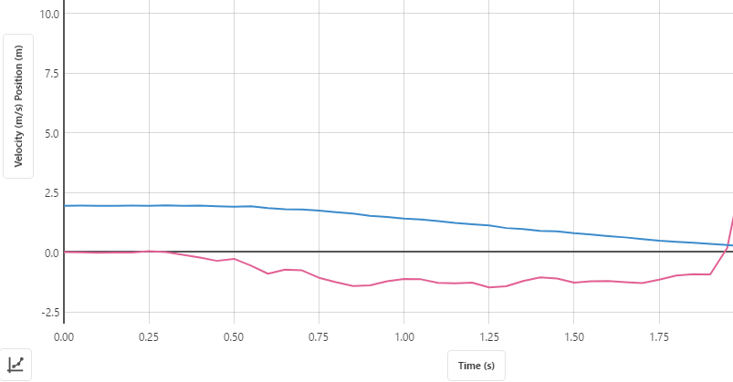
Experimental Drop Test Data
Representative Test (lightest system)
An ultrasonic motion sensor was used to collect position and velocity data on several drop tests.
Release
Position
Terminal Velocity Reached (velocity line becomes flat)
Velocity
System accelerating from release (Drag less than Weight)
Terminal Velocity (Drag = Weight)

Slide 29
Experimental Drop Test Data
Additional Drop Tests…
Terminal Velocity (Ave): 1.17 m/s (7 trials)
Experimental Results
Fall Distance until Terminal Vel: ~0.3 m
The average Terminal Velocity was determined by looking at several points along the terminal descent and averaging the velocities from each test. Those averages were then averaged together to get a single velocity number.

Slide 30
Alternate Experimental Approach - Using a Stop Watch
Fall Distance
Vel_{Ave} = -------------------
Fall Time
Trial | Drop Time (sec)
1 | 0.90
2 | 0.97
3 | 1.00
4 | 1.03
5 | 0.97
6 | 1.03
7 | 1.00
8 | 1.00
1.2 m
Vel_{Ave} = -------------------
0.99 sec
Vel_{Ave} = 1.2 m/sec (vs. 1.17 w/ motion sensor)
These stop watch fall times and the average velocity were consistent with tests run using an ultrasonic motion sensor to measure fall velocity. This means using a stop watch to determine descent time (and thus average velocity) is a reasonable experimental approach (as long as terminal velocity is maintained).
Average: 0.99 sec
Fall Distance: 1.2 m

Slide 31
The drop tests using an ultrasonic motion sensor and lightly loaded test parachutes indicate that terminal velocity was achieved fairly quickly.
In all of the tests, the data indicates that terminal velocity was achieved for all three suspended weights.
When using the stop watch approach, the test parachutes should be allowed to fall for approximately 0.3 m before stating the stop watch. This will ensure that terminal velocity has been achieved.
Distance needed to reach Terminal Velocity. Assume 0.3 m
Overall Drop Height
At least 2 m
Distance used to determine velocity. Measure time to fall this distance.

Slide 32
Collecting Fall Time and Calculating Descent Velocity
d = _________ | Parachute System #1 |  | Parachute System #2 |  | Parachute System #3
 | Descent Time | Calculated Velocity | Descent Time | Calculated Velocity | Descent Time | Calculated Velocity
 | sec | m/sec | sec | m/sec | sec | m/sec
Drop Test #1
Drop Test #2
Drop Test #3
Drop Test #4
Drop Test #5
 | Ave Velocity |  | Ave Velocity |  | Ave Velocity
d = Drop Distance (m)
Descent Time = Time from when the chute is released to when it hits the ground
Velocity = Drop Distance / Time = m / sec

Slide 33
Calculating the Drag Coefficient
DRAG = ½ x Atmospheric Density x Velocity² x Drag Coefficient x Area
Atmospheric Density = 1.225 kg / m³
Velocity = Measured from tests (don’t forget to square this value in the equation)
Area = Area of the canopy when it is laid out flat (square meters)
Drag = Weight in Newtons (since we assume the parachute is in terminal velocity)
2 x Weight
Cd = ---------------------------------------------------------------
Atmospheric Density x Velocity² x Area
m
2 x kg x ---------
sec²
Cd = ---------------------------------------
kg m²
-------- x -------- x m²
m³ sec²
All units cancel and Cd is a unitless coefficient (as it should be…)

Slide 34
Drag Coefficient Calculations
 | Parachute Sys 1 | Parachute Sys 2 | Parachute Sys 3
Average Velocity (m/sec)*
Canopy Area (m²)
Suspended Weight (N)
Atm Density (kg/m³) | 1.225 | 1.225 | 1.225
Drag Coefficient
2 x Weight
Cd = -----------------------------------------------------------
Atm Density x Velocity² x Canopy Area
* Use the average velocity from previous table (don’t forget to square the velocity in the calculation…)

Slide 35
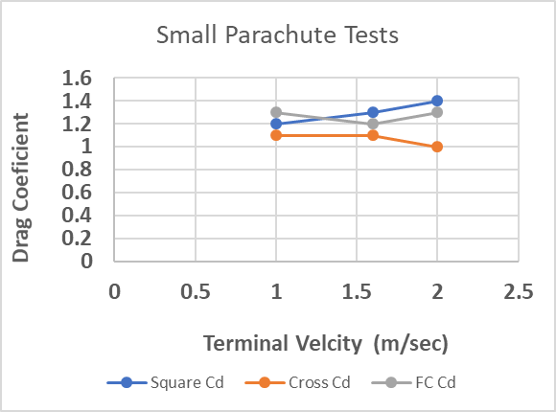
Sample Test Results for Three Parachute Shapes
The Cd’s obtained from test tests are higher than those for full scale parachutes. The data also shows that the Cd varies with descent velocity (more suspended weight = higher fall velocity)

Slide 36
Measured Drag Coefficients for Small Test Parachutes
Chute Type | Drag Coefficient (ave)
Flat Circular | 1.3
Square | 1.3
Cross | 1.1
These values are about double those for full-scale parachutes.

Slide 37
Why Does the Cd seem to vary with the Terminal Velocity?
The Cd table shows variations in the Cd as a function of the Terminal Velocity. In the tests, the Terminal Velocity was driven by the suspended weight. The data shows 10% - 20% variation, but the effect is not consistent – sometimes its higher and sometimes it lower for the higher velocities.
In an effort to be thorough, the canopy shapes were examined at different suspended loads. It is possible that the heavier weights changed the physical shape of the canopy, and thus affected the drag characteristics. The following slide shows frame capture images of the square canopy during the lightly loaded and heavily loaded tests. There seems to be very little difference in the canopy shapes…
Conclusion: The variations in Cd are probably due to uncontrolled variables during the tests. Factors could include air circulation in the lab, friction as the parachute moved down the guide line, sensor noise, etc.

Slide 38
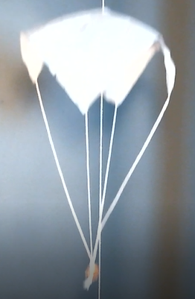
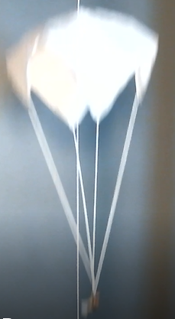
Images of square canopy during drop tests.
The red dashed canopy bubbles are identical in size.
Observations:
The canopy geometry is drastically different
Suspended load (red circle) is lower for the heavily loaded chute which indicates the canopy is closed more…
Lightly Loaded Chute
(0.04 N)
Heavily Loaded Chute
(0.16 N)

Slide 39
Why is the Flat Circular Cd larger that the Cross Cd ?
The drag, and thus Drag Coefficient, is dependent on how much frontal area is presented to the airflow. The larger the frontal area, the larger the drag.
In the following slide you can see a comparison of the Flat Circular and Cross Parachutes under identical loading conditions. The images show that the Flat Circular chute presents more frontal area to the airflow and thus generates a larger drag. The larger drag results in a larger calculated Cd. Recall that the Drag Equation is based on the area of the canopy when it is laid out flat – not an area that is “presented” to the airflow...
In the image, it is evident that much of the cross canopy hangs straight down. This effectively reduces the frontal area that is presented to the airflow, thus effectively reducing the “S” in the Drag Equation. The benefit of using a cross canopy is its inherent stability (lack of swing during descent). The vertical material damps out the oscillations.

Slide 40
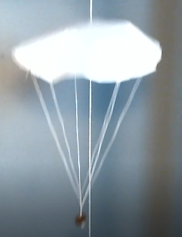
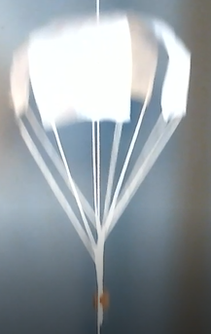
Flat Circular and Cross Canopies with same Suspended Loads
In these video frame captures, it is evident that the Flat Circular canopy presents a larger frontal area to the air flow than the Cross Parachute. Notice how much of the Cross Canopy is actually vertical.
The Green Area on the Cross Parachute image approximates the frontal area of the cross canopy. This area is smaller due to the cutouts between the canopy panels and the fact that a good portion of the cross canopy hangs straight down, parallel to the airflow…

Slide 41
Why don’t the model Cd’s match full-scale Cd’s ?
The drag coefficients obtained from the tests are higher than those for the full-scale parachutes:
Chute Type | Small Model Cd | Full Scale Cd
Flat Circular | 1.3 | 0.78
Square | 1.3 | 0.73
Cross | 1.1 | 0.70

Slide 42
Why don’t the model Cd’s match full-scale Cd’s ?
When testing sub-scale models, maintaining dimensional equivalency is not the only important consideration. The relationship between inertial and viscous forces must also be considered. The inertial and viscous forces are related though a ratio known as the Reynolds Number (Re):
Air Density x Velocity x Characteristic Length
Re = -----------------------------------------------------------------
Dynamic Viscosity of Air
For wind tunnel testing (and drop testing) results to be scaled up to full-scale objects, the test models must be tested at a Reynolds Numbers that are equivalent to that of the full-scale object.

Slide 43
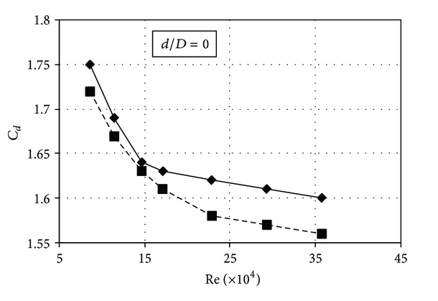
Effect of Reynolds Number on Drag Coefficient
Since models are smaller (smaller Characteristic Length), they must be tested at higher velocities or higher densities to achieve the needed equivalency. As for the testing outlined in this lesson, the test velocities would have to be significantly higher to achieve equivalency with full-scale parachutes – and the tissue paper chutes would be torn to shreds!
As the generic test data in the figure at the right shows, the drag coefficient decreases as the Reynolds Number increases.
This means that if the test parachutes were somehow tested at higher velocities, the resulting drag coefficients would tend towards those of the full-scale parachutes.

Slide 44
Sizing the canopy is only half the battle…
The parachute has to survive the deployment and stay attached to the payload.

Slide 45
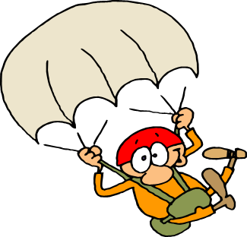
Questions?

